Slide 1
St Vrain Valley School District Grant Request
for the Lake Titicaca Frog Project with the Denver Zoo
1

Slide 2
Important Questions for your Consideration:
Why is the Lake Titicaca frog important?
How does human-environment interaction affect the frogs?
Why should we care?
Why are high school students a good option for these kinds of projects?
What can IEEE do to help?
2

Slide 3
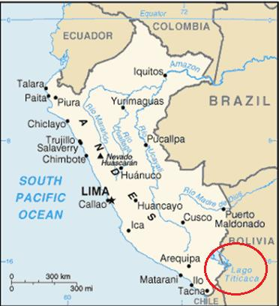
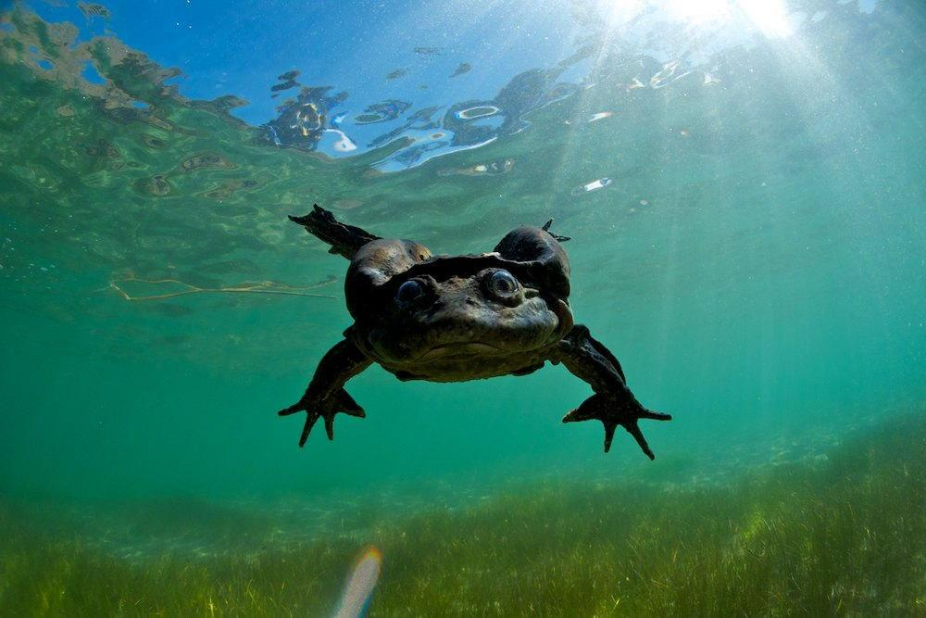
The Titicaca Water Frog
(Telmatobius Culeus)
Endemic to Lake Titicaca
Largest Aquatic Frog (20 inches outstretched)
Critically Endangered
Human Consumption
Habitat Loss
Habitat Pollution
Invasive Species (North American Trout)
3

Slide 4
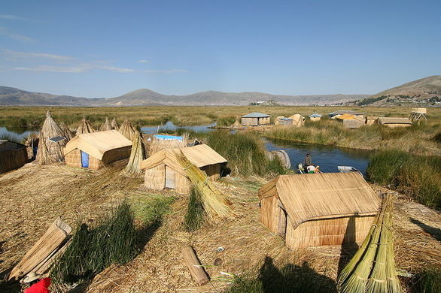
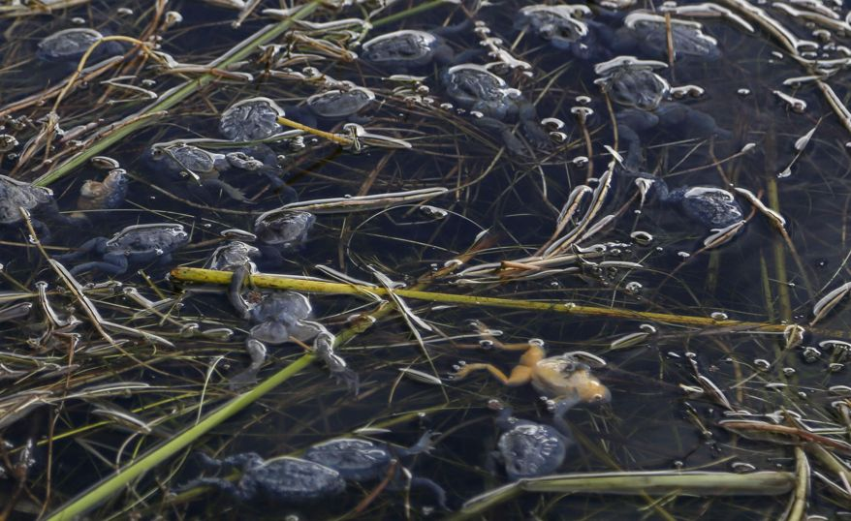
Human Environment Interaction (HEI)
Overharvesting
medicinal purposes
economic support
lack of education
Pollution
Lack of water treatment
Urban Runoff
Illegal factories
Population
1,000,000+ people live in the lake’s vicinity
4

Slide 5
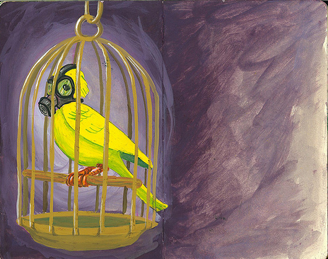
Why Should We Care?
5

Slide 6
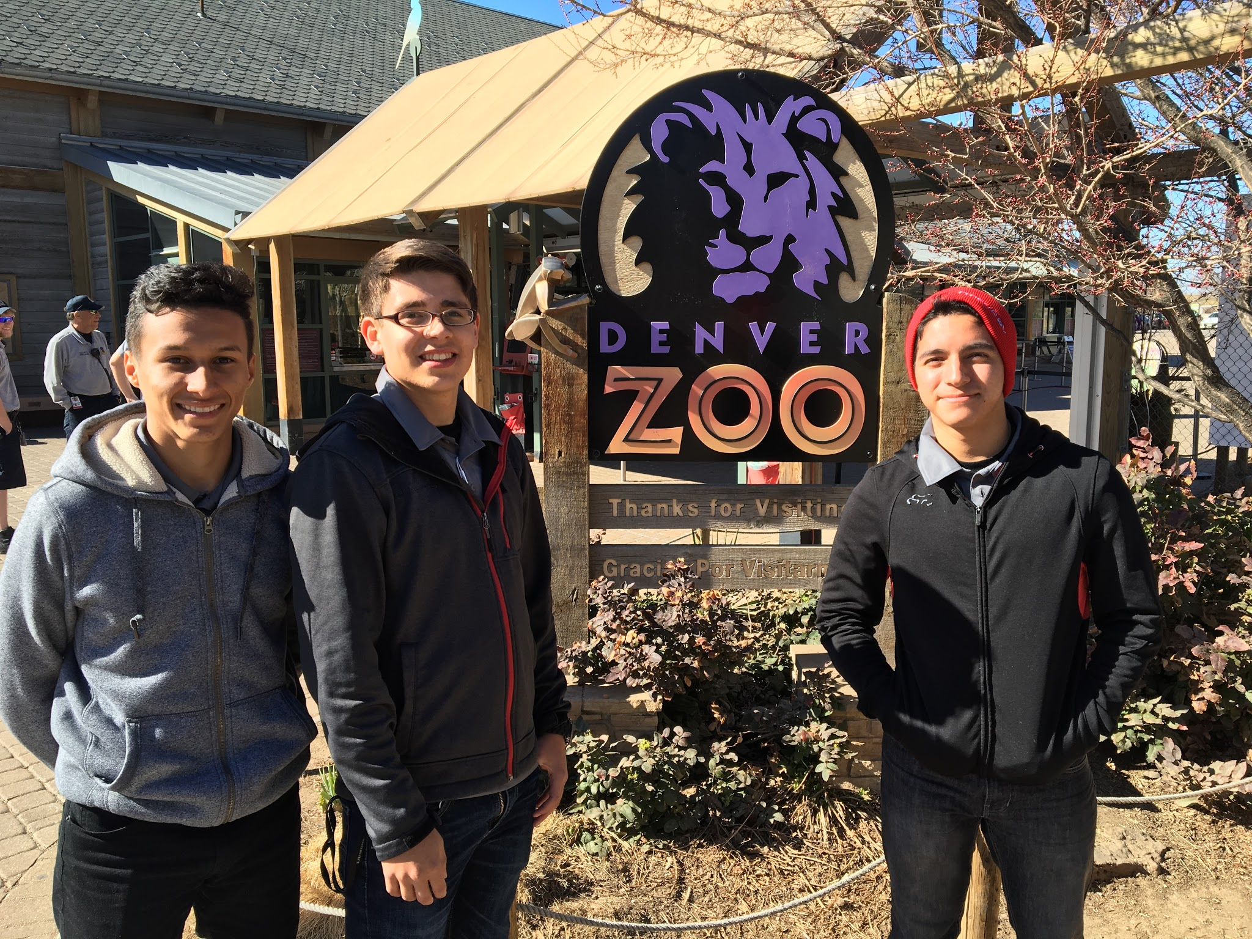
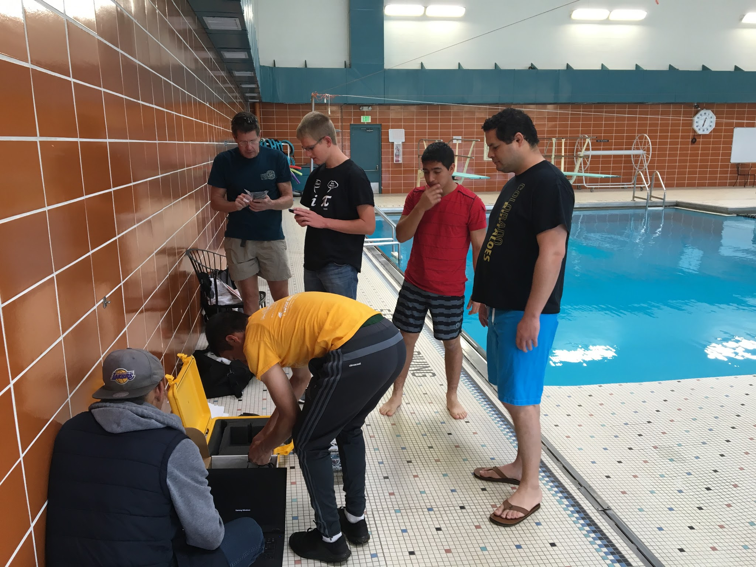
Student Involvement
The Denver Zoo asked students at the SVVSD Innovation Center for help in their conservation efforts by building ROVs.
6

Slide 7
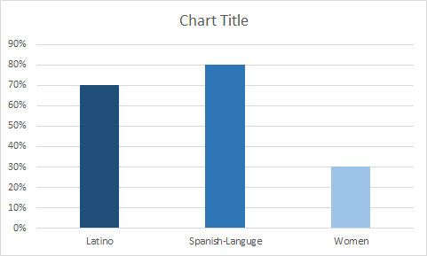
Our Team
10 students
2 mentors
8th - 11th Grade
Skyline and Niwot High Schools
Sunset Middle School
Meets with engineering and conservation experts
Intelligent, creative, productive
Compassionate
Demographics
7

Slide 8
Our Goals
Build Multiple ROVs to allow for greater research on the frogs deeper in the lake
Population Count
Design education curriculum
Bolivian and Peruvian students
SVVSD students
Generate Publicity
Get people educated on the subject
Develop partnerships with Denver Water and Boulder County
Extend engineering opportunities to a wide range of students using low cost alternatives
8

Slide 9


What Can IEEE Do?
9

Slide 10
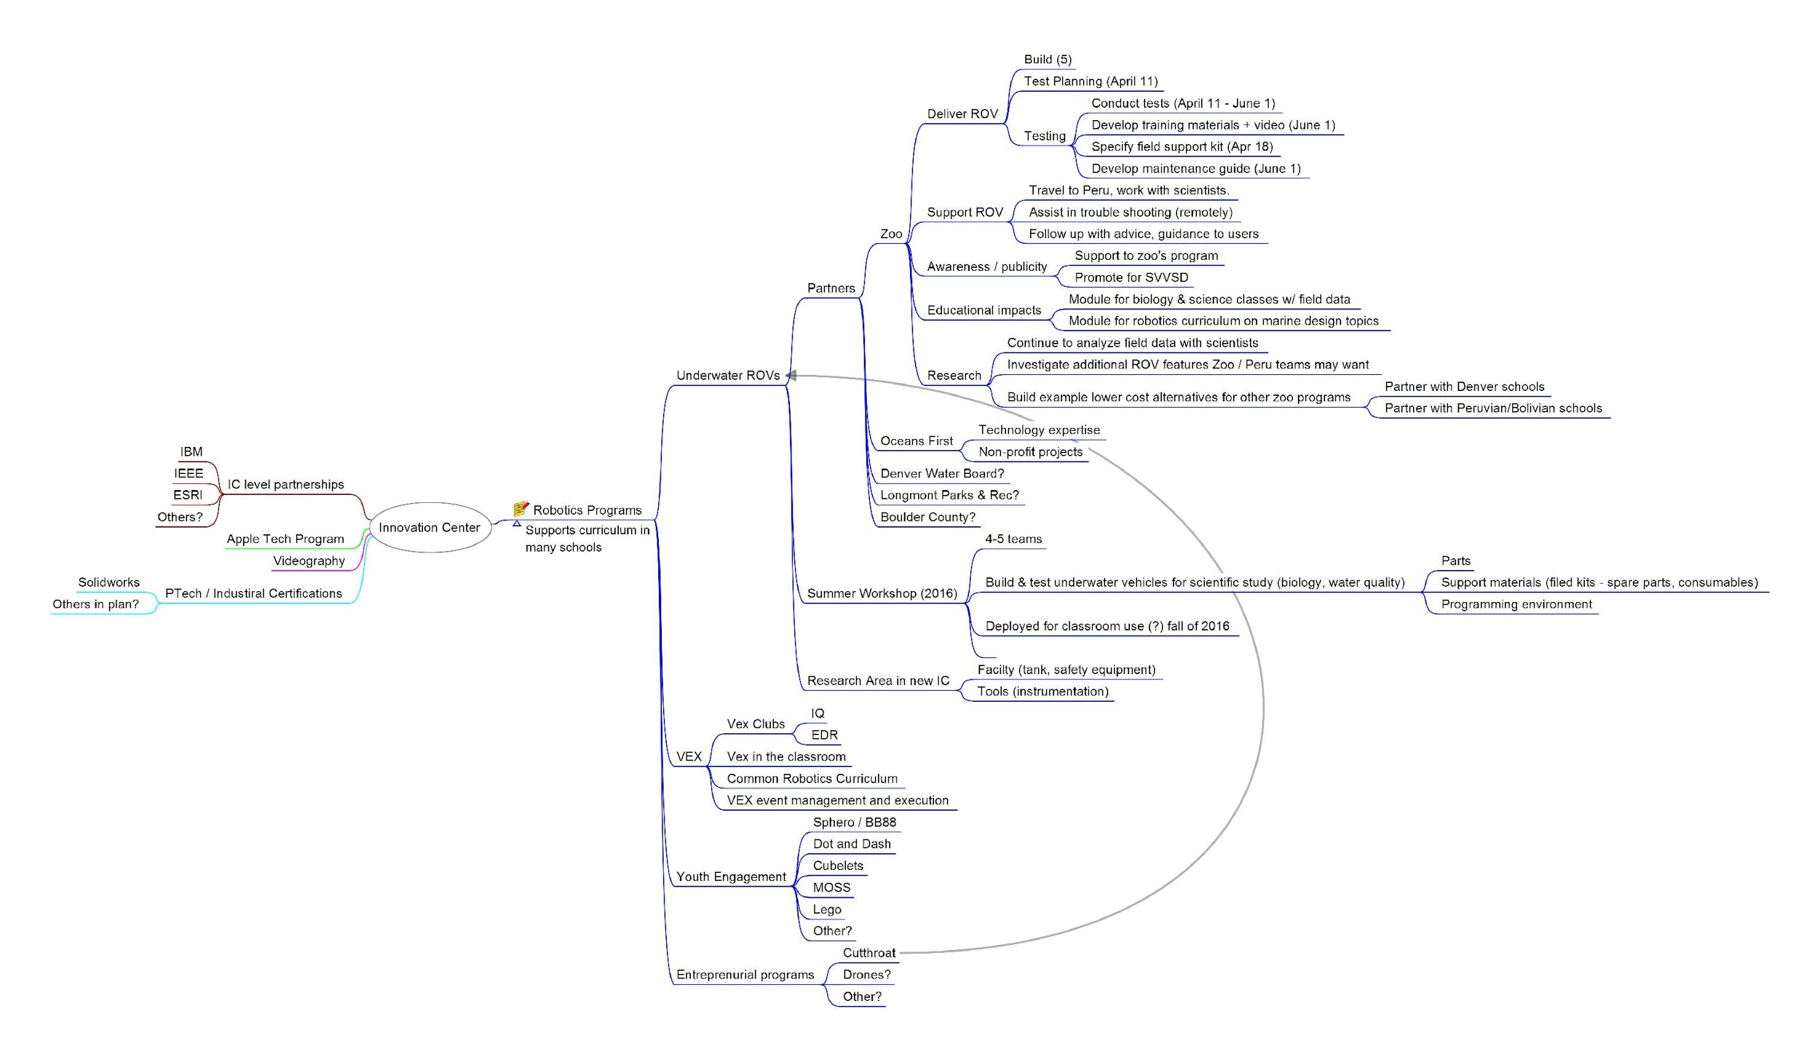
Where we'd like to see IEEE
Denver Chapter Grant
IEEE Foundation Grant
10

Slide 11
Project Investments
11

Slide 12
St Vrain Valley Schools
SVVSD Innovation Center
Zoo project support
Staff (mentors, teachers)
Space
Tools, computers, and support equipment
Support for students
Public relations
Aquatic robotics summer camp (2 weeks)
Staff (mentors and teachers)
Development of curriculum
Training materials for camp and curriculum
Space
Tools, computers, and support equipment
Support for students
Public relations
12

Slide 13
Planned IEEE Grant Requests
Denver Section IEEE Grant - ~$2,000
Zoo Project Support
Materials for two low-cost alternatives (see attached BOM)
Field support kit for each alternative ROV
Software development environment for the microcontroller
Opportunities to publish/present on project
IEEE Foundation Grant - ~$10,000 - 15,000
Aquatic Summer Camp – Pilot for ongoing aquatic conservation partnerships
Materials for ROVs (6x)
Development environment licenses
Surface controls for each ROV
Field support kit for each ROV
Publication of curriculum
Large tank(s) for vehicle testing (1 trough, 1 acrylic)
Opportunities to present
13

Slide 14
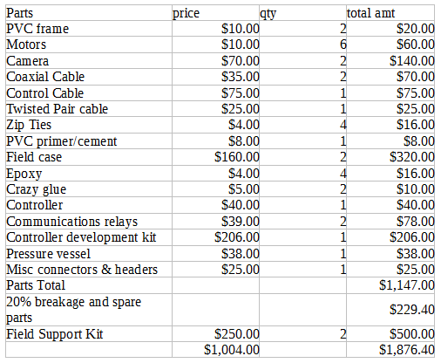
Bill of Materials for Denver Section Grant:
14

